Slide 1


Data Analytics For DHL LogisticsFacilities
Category: Data Analytics
ORGANISED BY: IBM

Slide 2

TEAM DETAILS
Our Team Members: TEAM ID:
1.YUVANBALA B PNT2022TMID01215
2.VISHNU VARSHAN.S
3.SELVAGANESH.R IBM PROJECT ID:
4.VIGNESHWAR.V 3619-1658584411

Slide 3
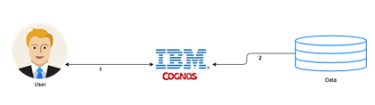
PROJECT DESCRIPTION
>>DHL is an international Umbrella brand and trademark for the courier, package delivery, and express mail service
which is a division of the German logistics firm Deutsche Post. The company group delivers over 1.6 billion parcels per year.
>>The company DHL itself was founded in San Francisco, USA, in 1969 and expanded its service throughout the world
by the late 1970s. In 1979, under the name of DHL Air Cargo, the company entered the Hawaiian Islands with an inter-island cargo service
using two DC-3 and four DC-6 aircraft. Adrian Dalsey and Larry Hillblom personally oversaw the daily operations until its eventual bankruptcy
closed the doors in 1983. At its peak, DHL Air Cargo employed just over 100 workers, management, and pilots.
Goal of the Project:
To provide Analytics to improve New Marks and grow the business
TECHNICAL ARCHITECTURE

Slide 4
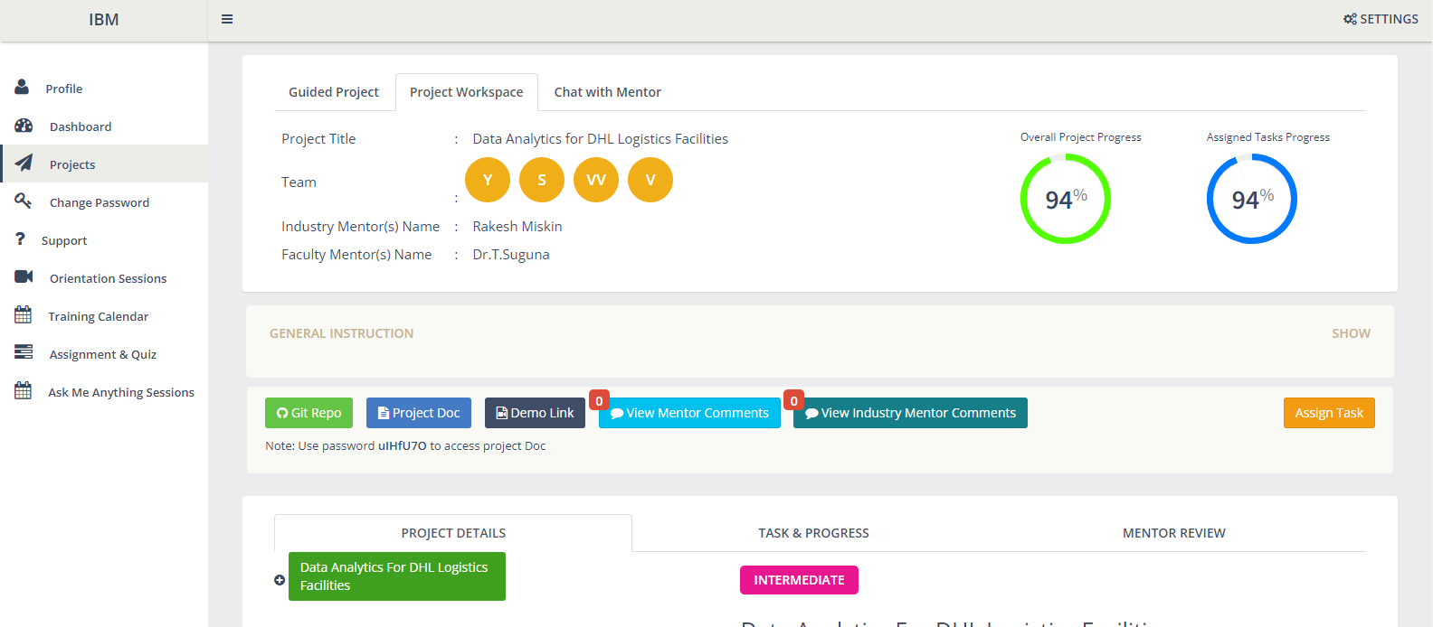
IBM ACCOUNT

Slide 5
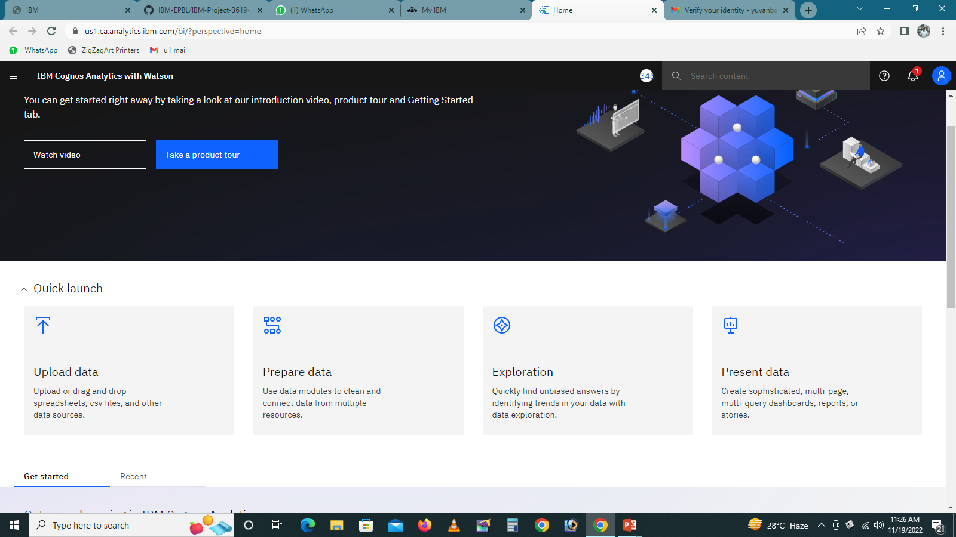
IBM COGNOS ANALYTICS

Slide 6
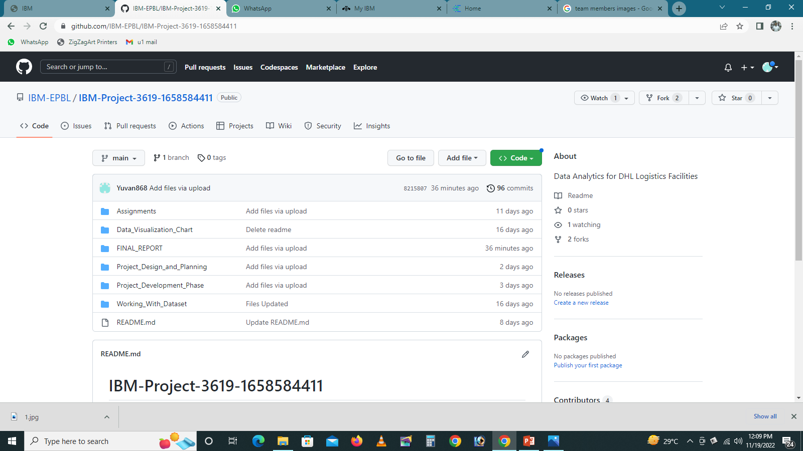
GITHUB

Slide 7
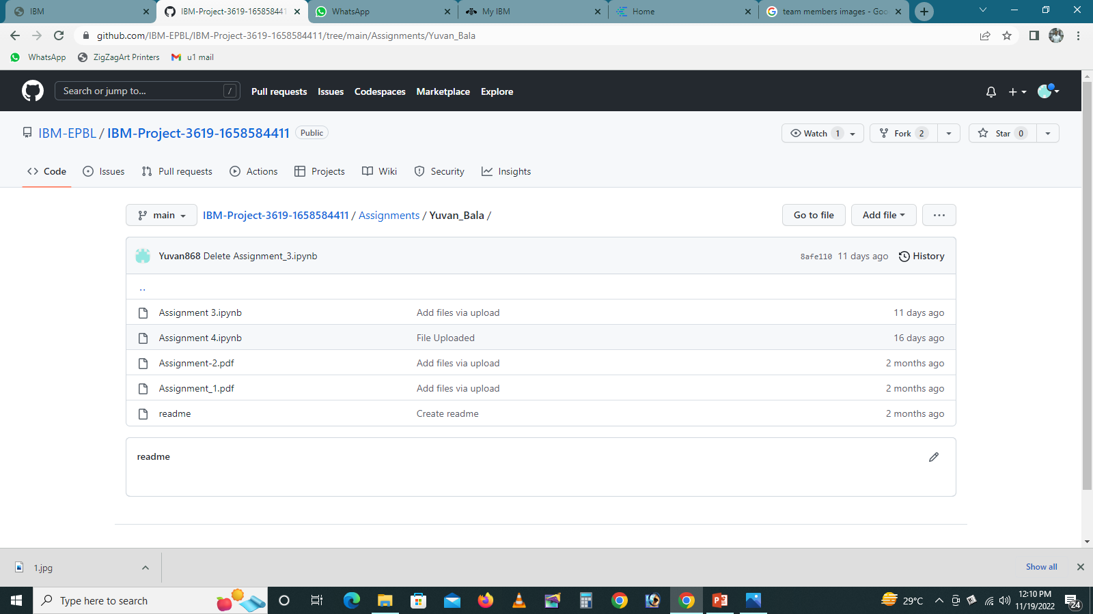
ASSIGNMENTS

Slide 8
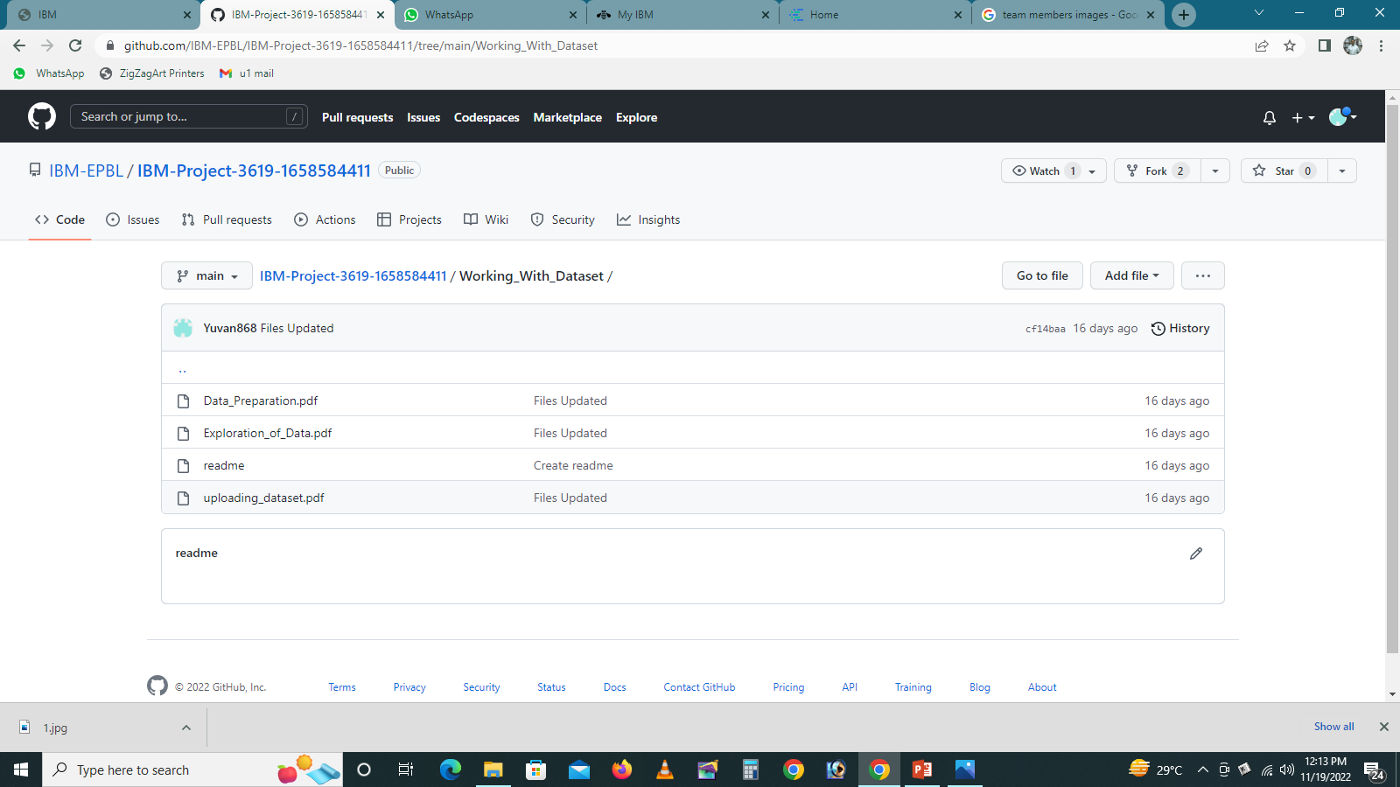
WORKING WITH DATA SETS
There are four sub tasks are assigned to this task. They are:
1.UNDERSTANDING THE DATASET
2.LOADING THE DATASET
3.DATA PREPARATION
4.EXPLORATION OF DATA

Slide 9
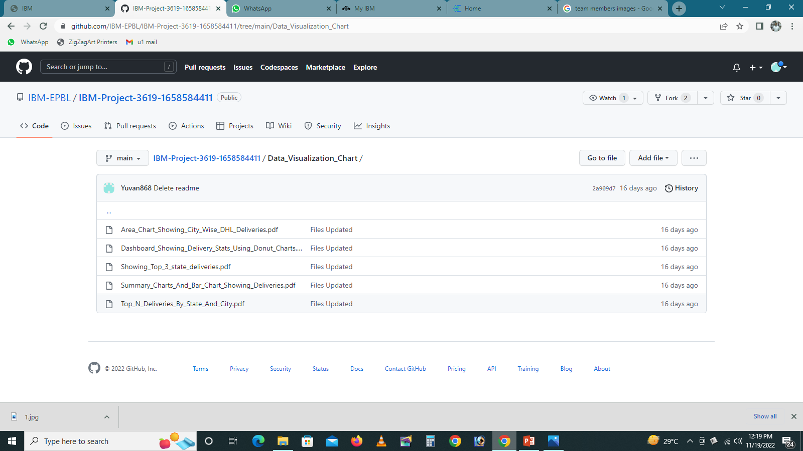
DATA VISUALIZATION CHARTS
There are five sub tasks are assigned to this task:
1.AREA CHART SHOWING CITY WISE DHL DELIVERIES
2.DASHBOARD SHOWING DELIVERY STATE USING DONUT CHARTS
3.SHOWING TOP 3 STATE DELIVERIES
4. SUMMARY CHARTS AND BAR CHART SHOWING DELIVERIES
5.TOP N DELIVERIES BY STATE AND CITY

Slide 10
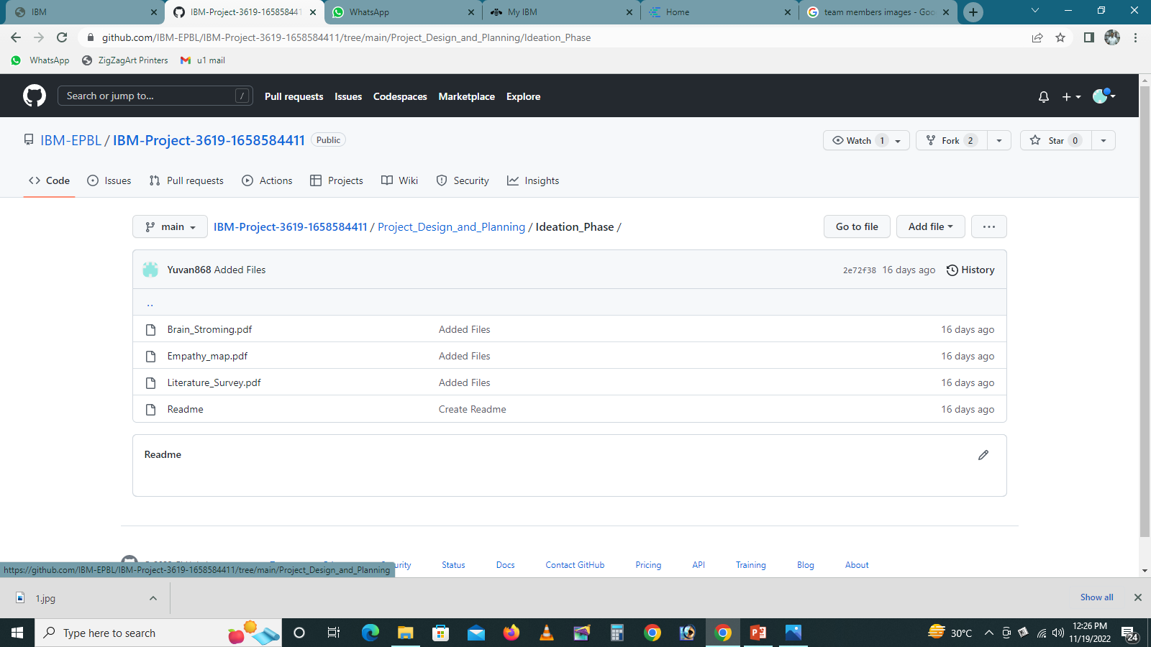
IDEATION PHASE
There are three sub tasks are there:
1.BRAIN STROMING
2.EMPATHY MAP
3.LITERATURE SURVEY

Slide 11
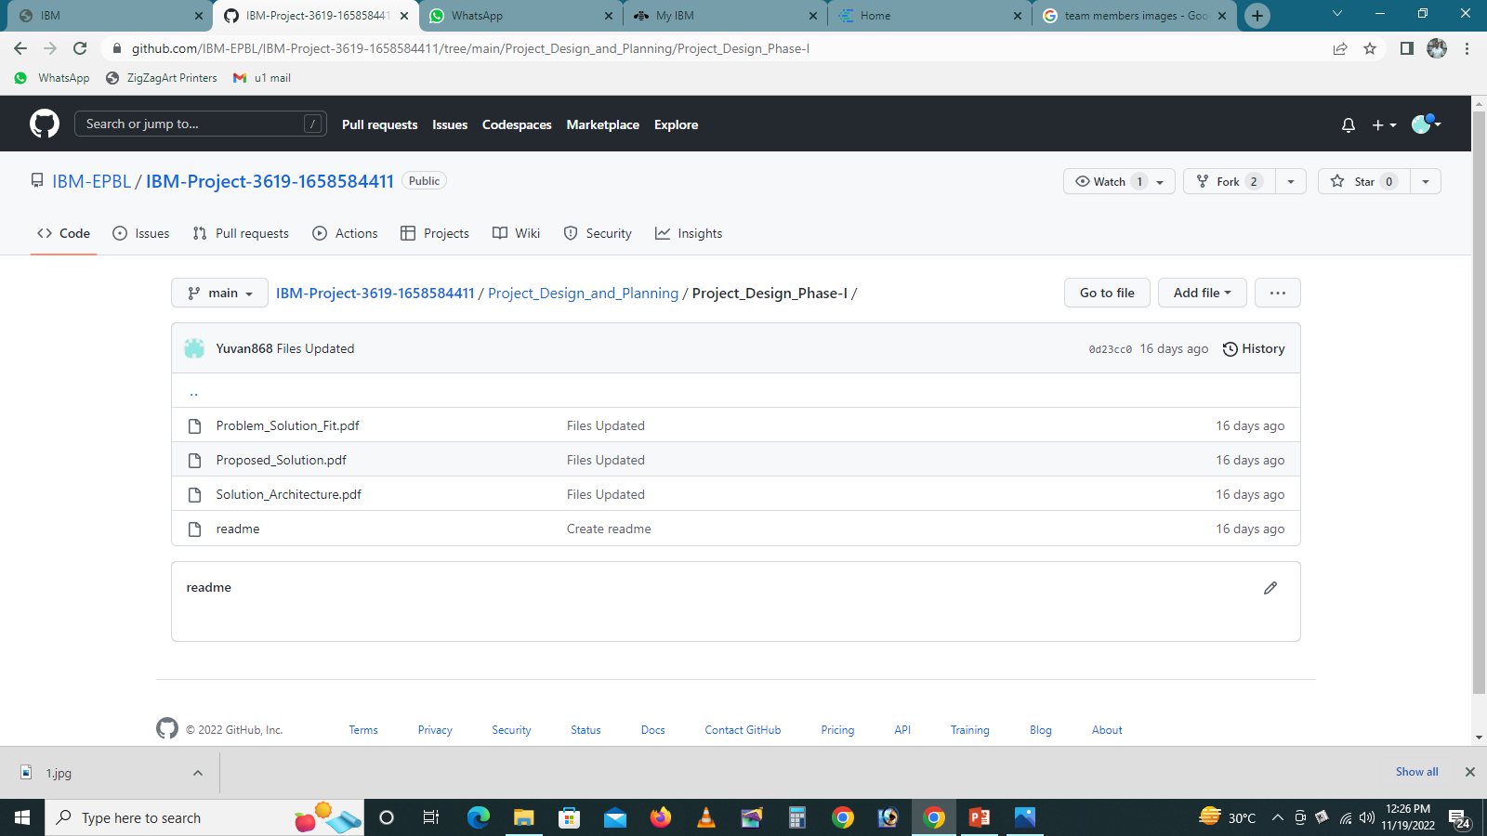
PROJECT DESIGN PHASE I
PROBLEM SOLUTION FIT
PROPOSED SOLUTION
SOLUTION ARCHITECTURE

Slide 12
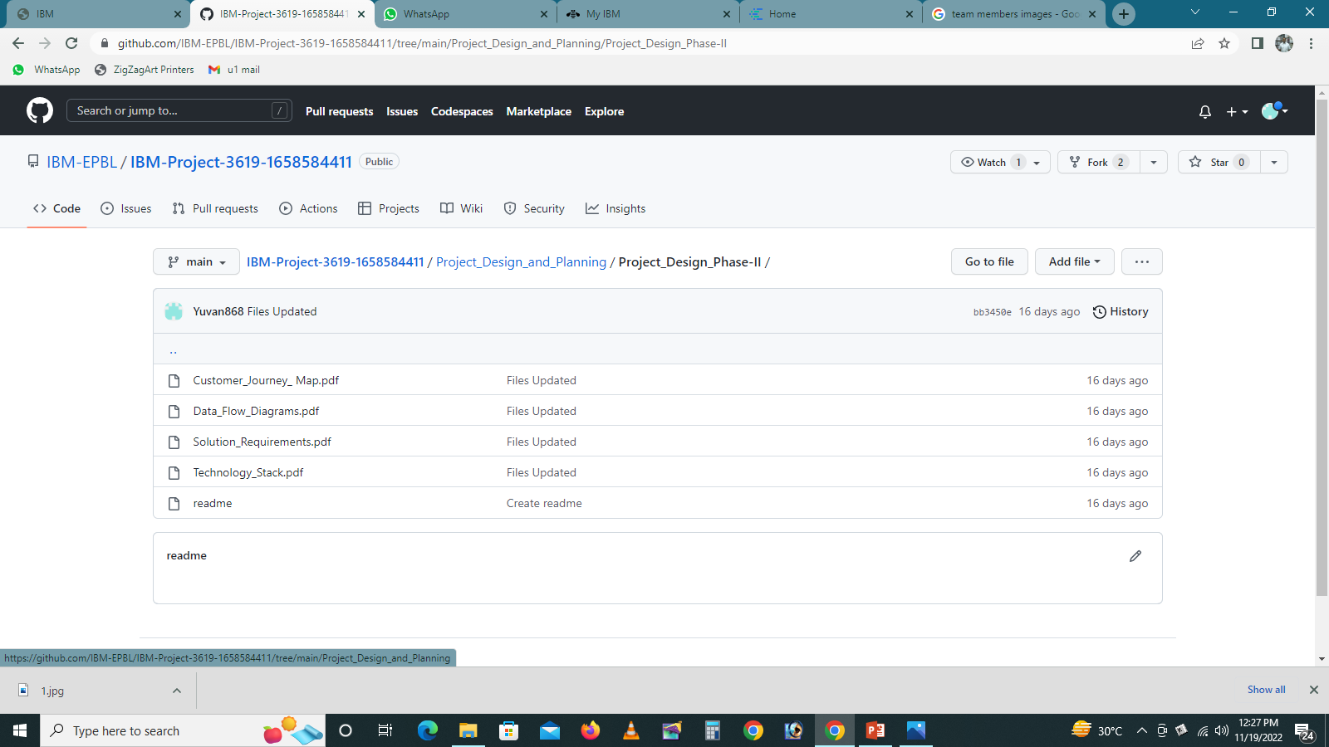
PROJECT DESIGN PHASE II
CUSTOMER JOURNEY MAP
DATA FLOW DIAGRAM
SOLUTION REQUIREMENTS
TECHNOLOGY STACK

Slide 13
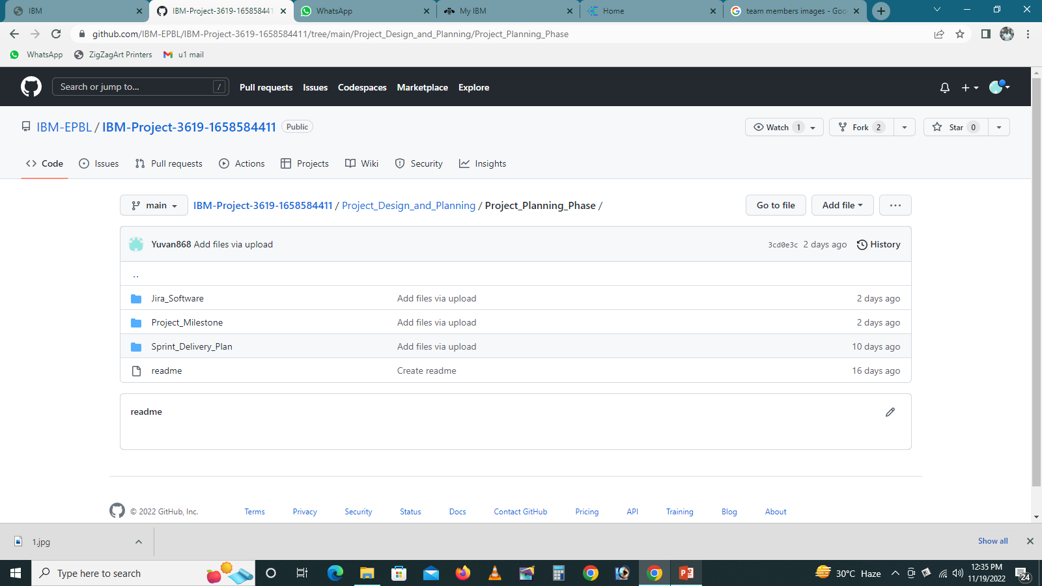
PROJECT PLANNING PHASE
MILESTONE
SPRINT DELIVERY

Slide 14
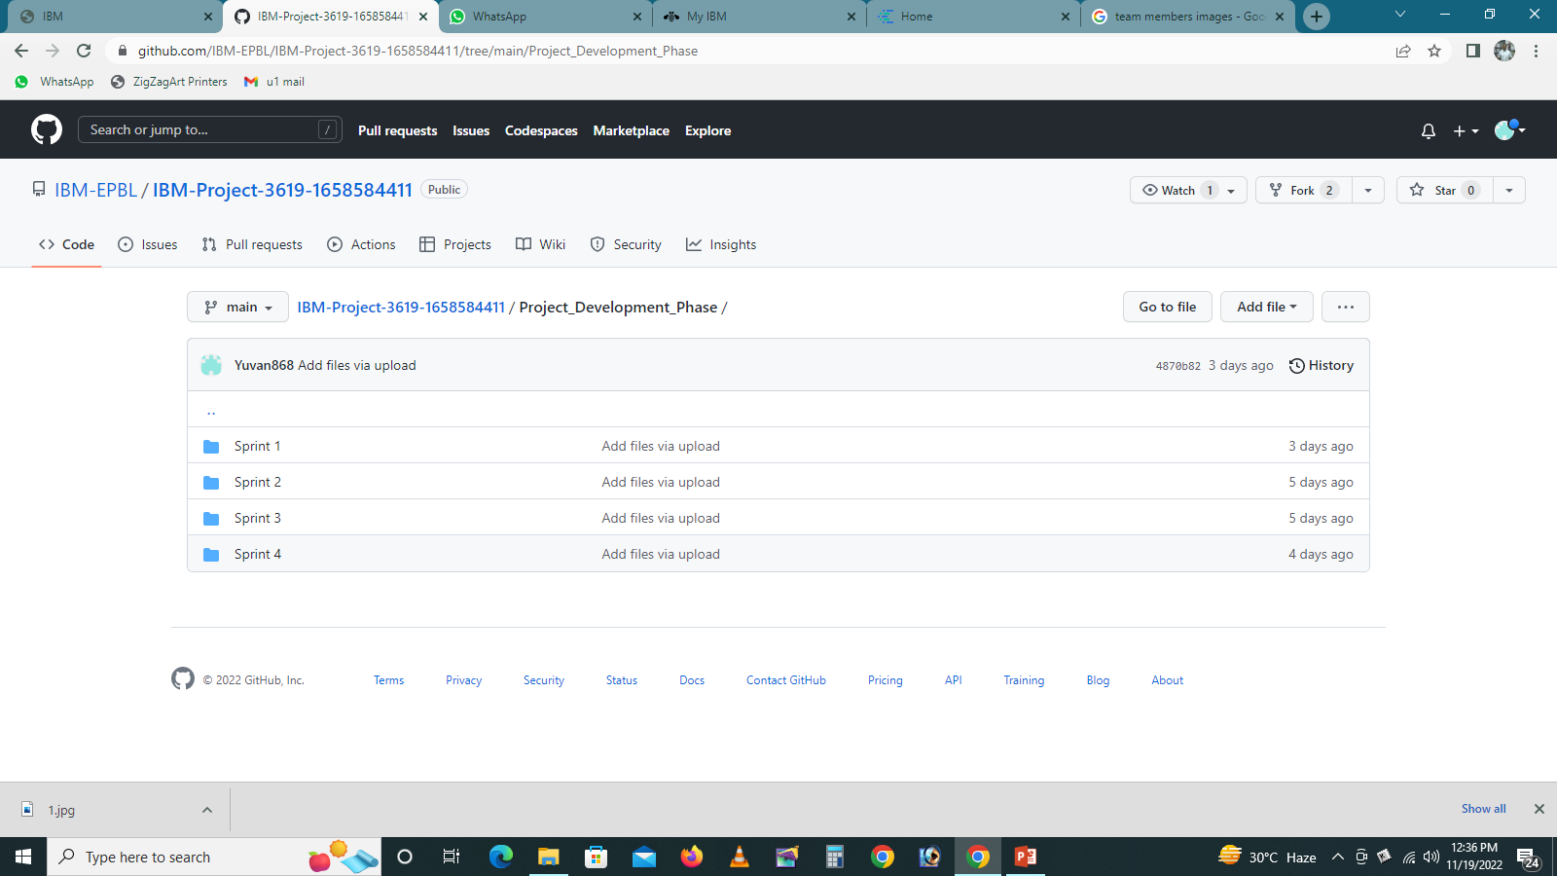
PROJECT DEVELOPMENT PHASE

Slide 15
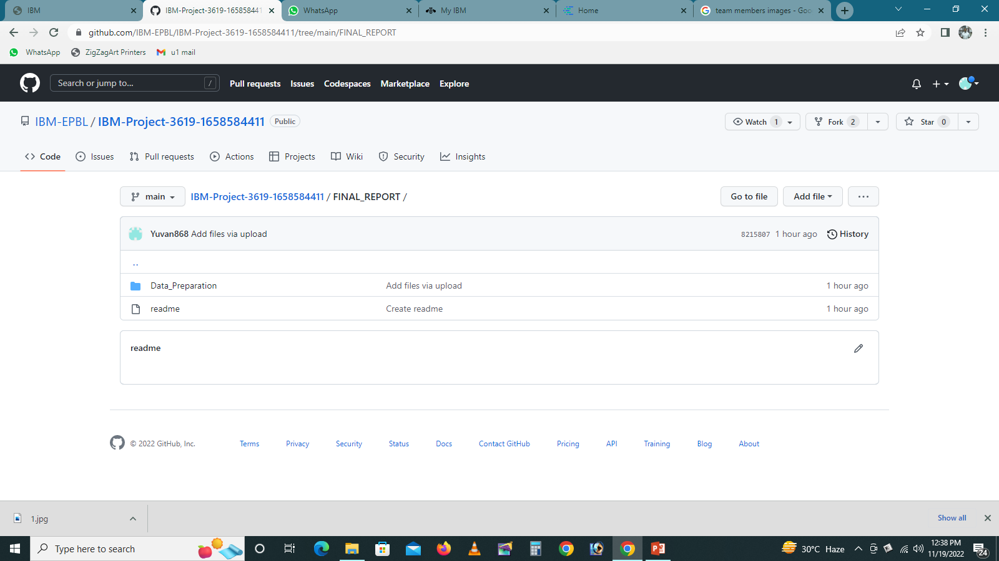
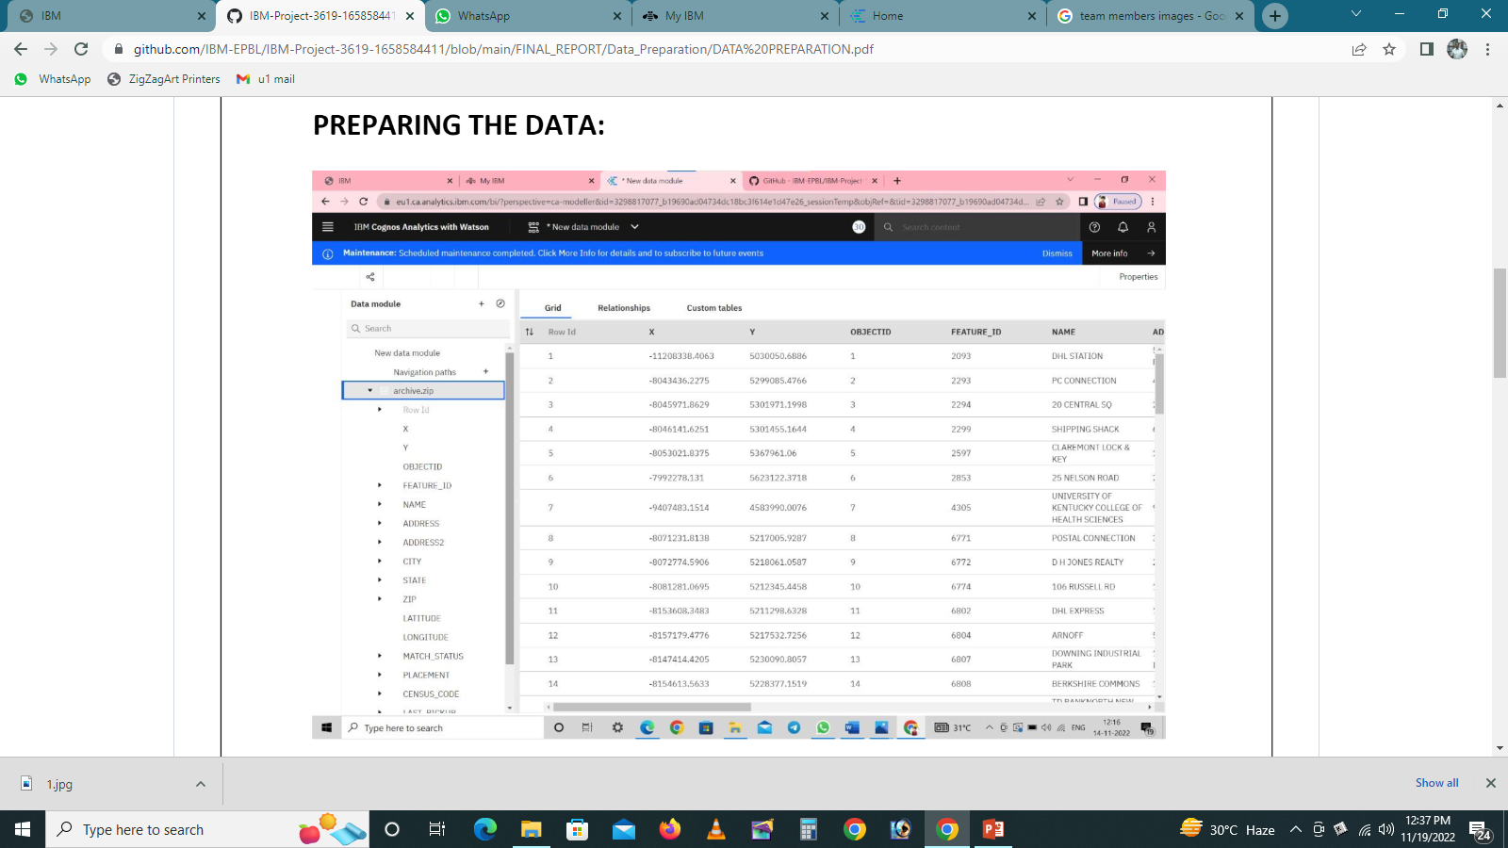
FINAL REPORT
PREPARED DATA SET
PREPARED THE REPORT
PREPARED THE DEMO VIDEO

